Slide 1
Chapter – Three
Financial Statement Analysis
[N -10 to 12 marks]

Slide 2
Concept of Financial Statement
Financial Statements provide a representation of a company’s financial performance over time.
Financial statements are written reports created by a company’s management to summarize the business’s financial condition over a certain period (quarter, six-monthly, or yearly).
Financial manager’s goal is to maximize the wealth of shareholders about the corporations affairs.
Corporation prepares various kinds of reports for reporting to the shareholders.
The financial statements contain the basic financial information about revenues, expenses, assets, liabilities and cash flows during a specified period.
Financial statement provides the strength and weakness of the company.
Financial statement includes income statement, balance sheet, cash flows statement and Retained earning statement etc.

Slide 3
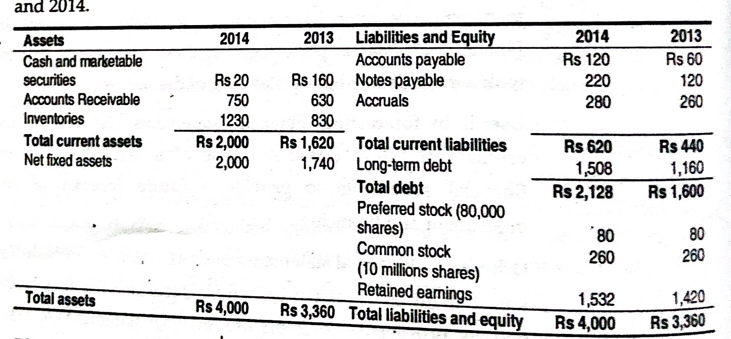
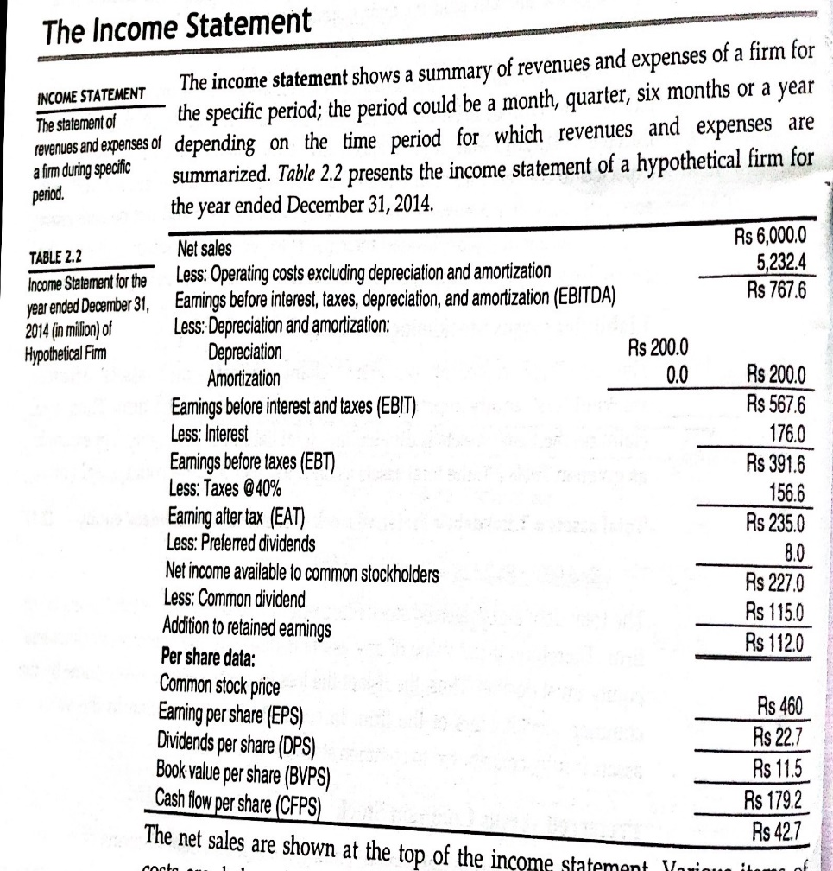
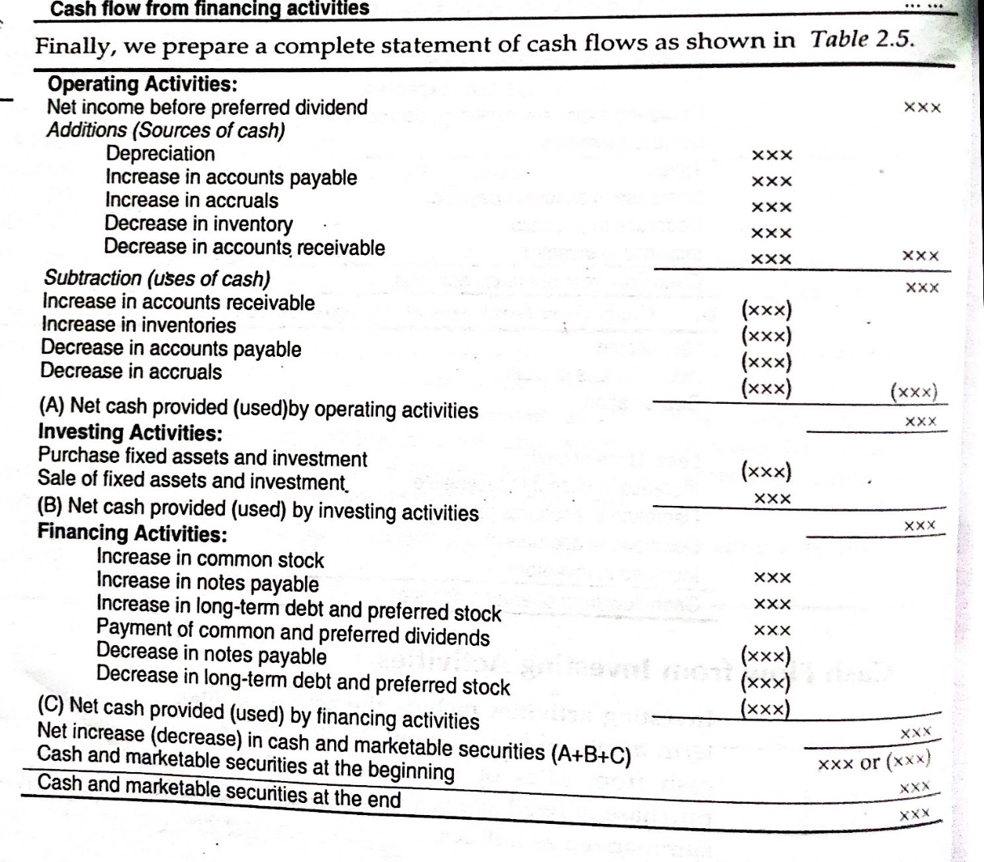
Format of balance sheet ,income statement and Cash flow statement

Slide 4
Uses of Financial Statement
Useful in investment decision
Useful in reporting
Useful in formulating plans and polices
Useful in expansion of credit
Useful in taxation decision

Slide 5
Concept of Financial Analysis
Financial analysis is a process of evaluating financial statement to obtain better understanding of a firm's position and performance.
There are various tools and techniques to analyze the financial statements.
Computation of different ratios by taking different but related accounting figures from balance sheet and income statement and interpretation of ratio is known as ratio analysis.
Financial analysis is a tool of measurement of financial strengths and weaknesses of the firm

Slide 6
Types of Ratios
A. Liquidity Ratios
B. Debt Management Ratios
C. Assets Management Ratios
D. Profitability Ratios
E. Market Value Ratios

Slide 7
1.Liquidity Ratios:-
Liquidity ratios measure a company's ability to pay off its short-term debts as they become due, using the company's current or quick assets. Liquidity ratios include the current ratio, quick ratio, and working capital ratio.
2. Solvency Ratios/Debt Management Ratios:-
Also called financial leverage ratios, solvency ratios compare a company's debt levels with its assets, equity, and earnings, to evaluate the likelihood of a company staying afloat over the long haul, by paying off its long-term debt as well as the interest on its debt. Examples of solvency ratios include: debt-equity ratios, debt-assets ratios, and interest coverage ratios.

Slide 8
3.Assets management Ratio
Also called activity ratios, efficiency ratios evaluate how efficiently a company uses its assets and liabilities to generate sales and maximize profits. Key efficiency ratios include: turnover ratio, inventory turnover, and days' sales in inventory.
4. Profitability Ratio:-
These ratios convey how well a company can generate profits from its operations. Profit margin, return on assets, return on equity, return on capital employed, and gross margin ratios are all examples of profitability ratios.
5. Market Value Ratios:-
These are the most commonly used ratios in fundamental analysis. They include dividend yield, P/E ratio, earnings per share (EPS), and dividend payout ratio. Investors use these metrics to predict earnings and future performance.

Slide 9
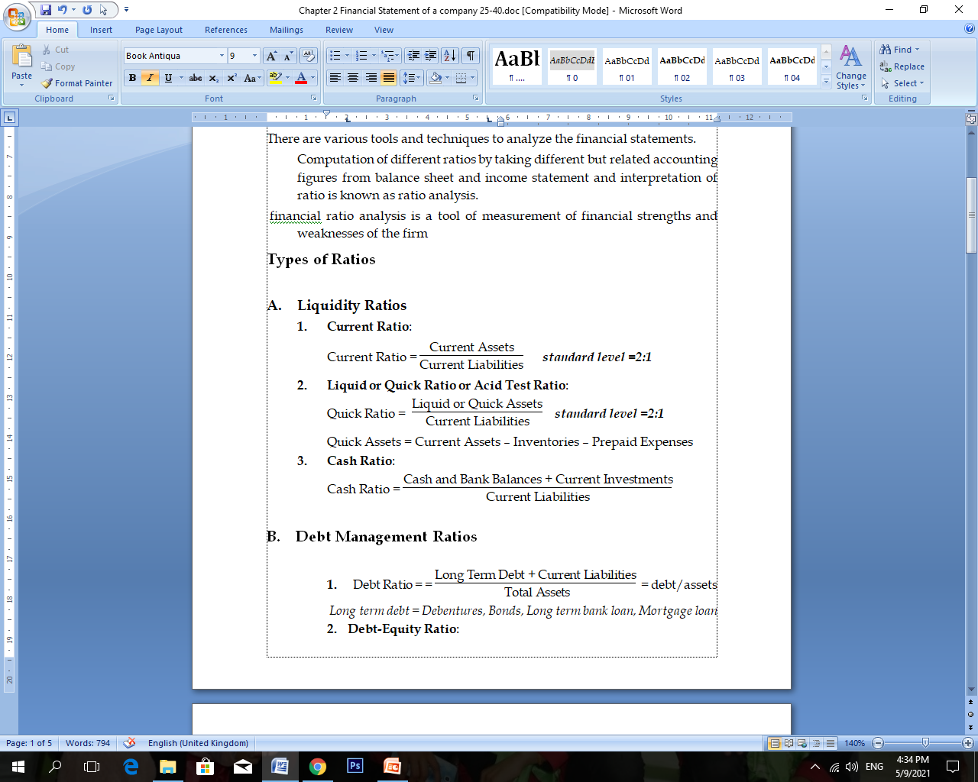
A. Liquidity Ratios

Slide 10
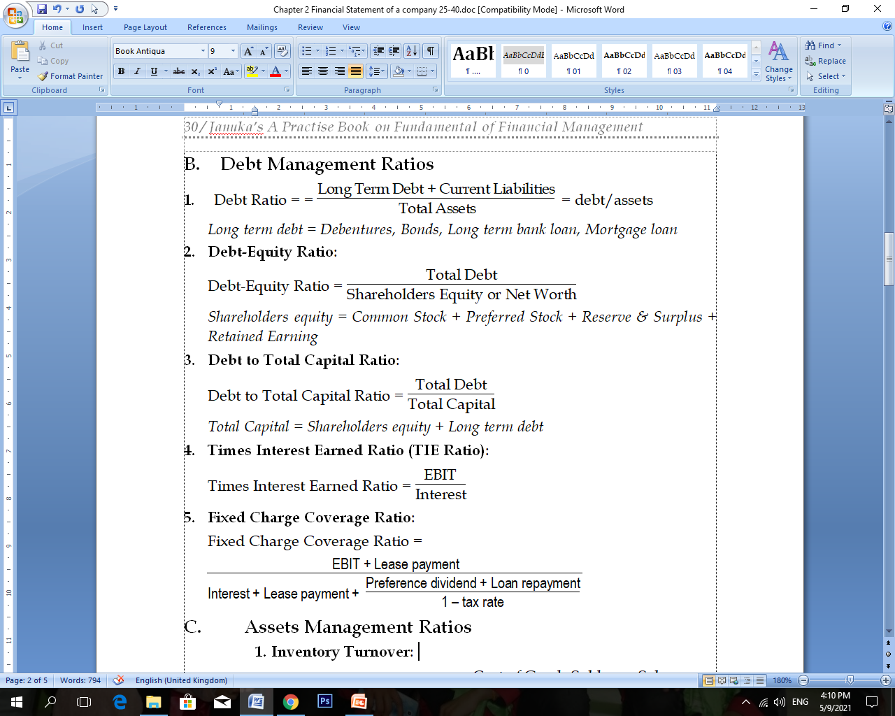
B. Debt Management Ratios

Slide 11
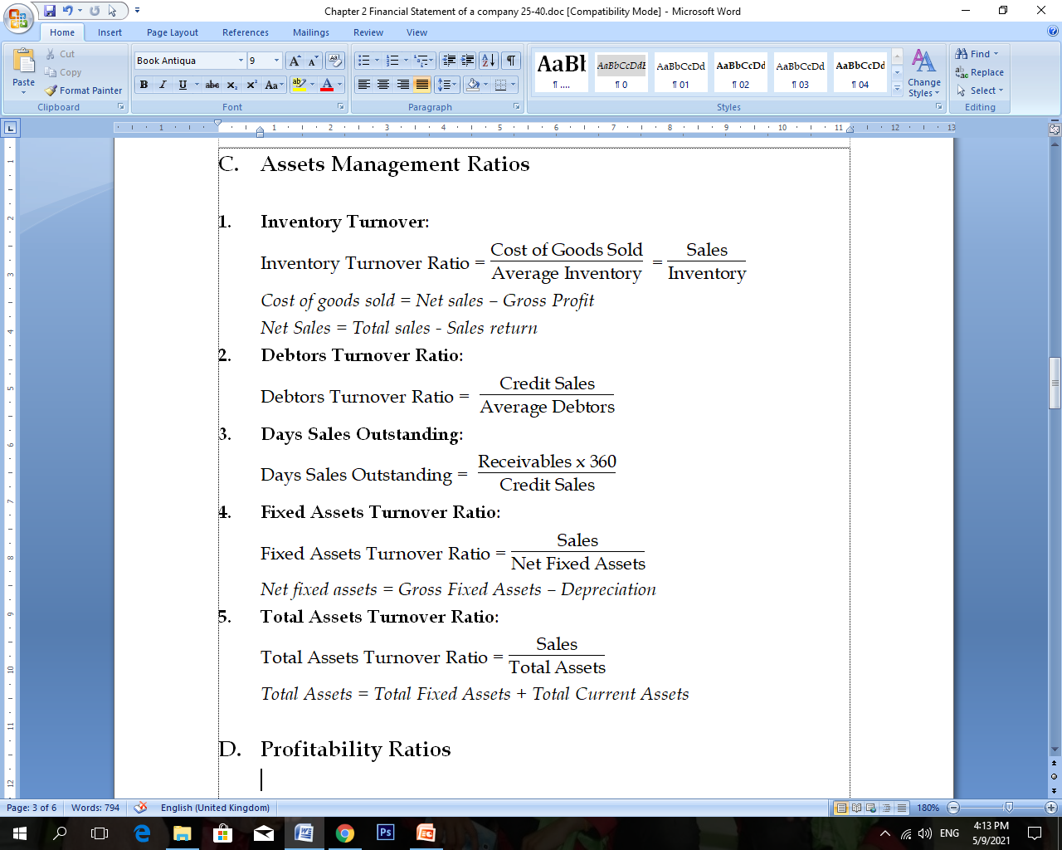
C. Assets Management Ratios

Slide 12
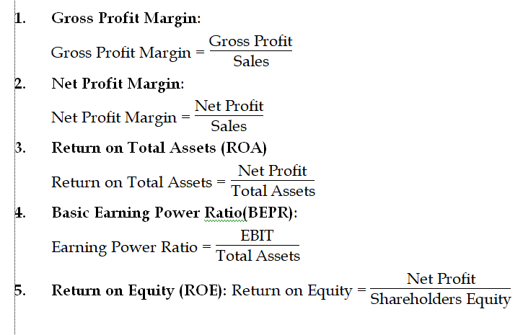
D. Profitability Ratios

Slide 13
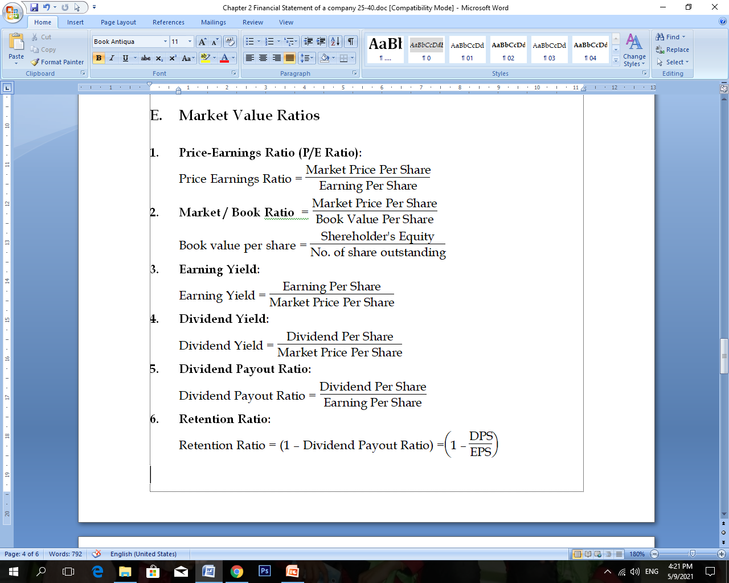
E. Market Value Ratios

Slide 14
Uses and importance of Ratio Analysis
a. Useful in analysis of financial statement:
b. Express financial trend:
c. Helpful in planning:
d. Facilitate in comparison:
e. Communicate strength and weakness:
f. Develop control mechanism:
g. Helpful in decision-making:

Slide 15
Limitation of Ratio Analysis
1. Ratio analysis information is historic – it is not current
2. Ratio analysis does not take into account external factors such as a worldwide recession
3. Ratio analysis does not measure the human element of a firm
4. Ratio analysis can only be used for comparison with other firms of the same size and type
5. it may be difficult to compare with other businesses as they may not be willing to share the information

Slide 16
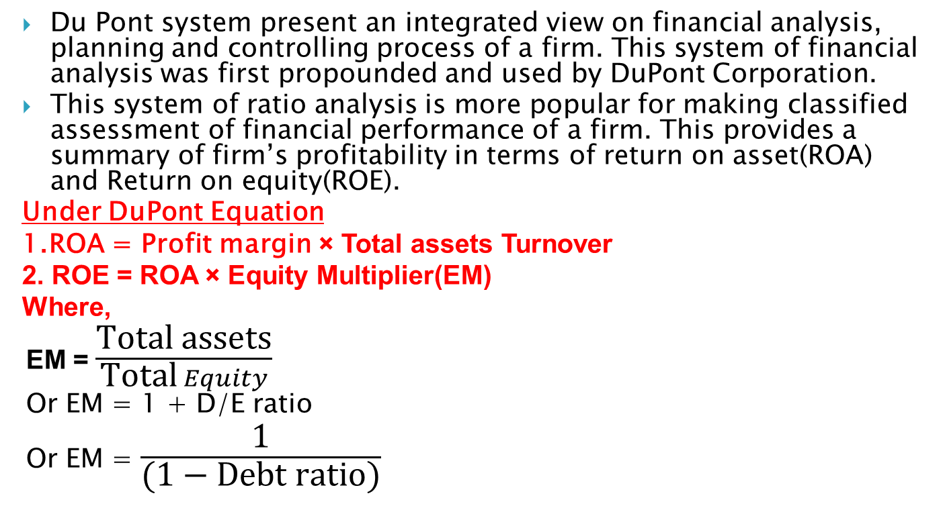
The DuPont Equation
Du Pont system present an integrated view on financial analysis, planning and controlling process of a firm. This system of financial analysis was first propounded and used by DuPont Corporation.
This system of ratio analysis is more popular for making classified assessment of financial performance of a firm. This provides a summary of firm’s profitability in terms of return on asset(ROA) and Return on equity(ROE).
Under DuPont Equation
1.ROA = Profit margin × Total assets Turnover
2. ROE = ROA × Equity Multiplier(EM)
Where,
EM = $\frac{\text{Total} \text{assets}}{\text{Total} Equity}$
Or EM = 1 + D/E ratio
Or EM = $\frac{\text{1}}{\text{(}\text{1 }\text{− }\text{Debt} \text{ratio}\text{)}}$

Slide 17
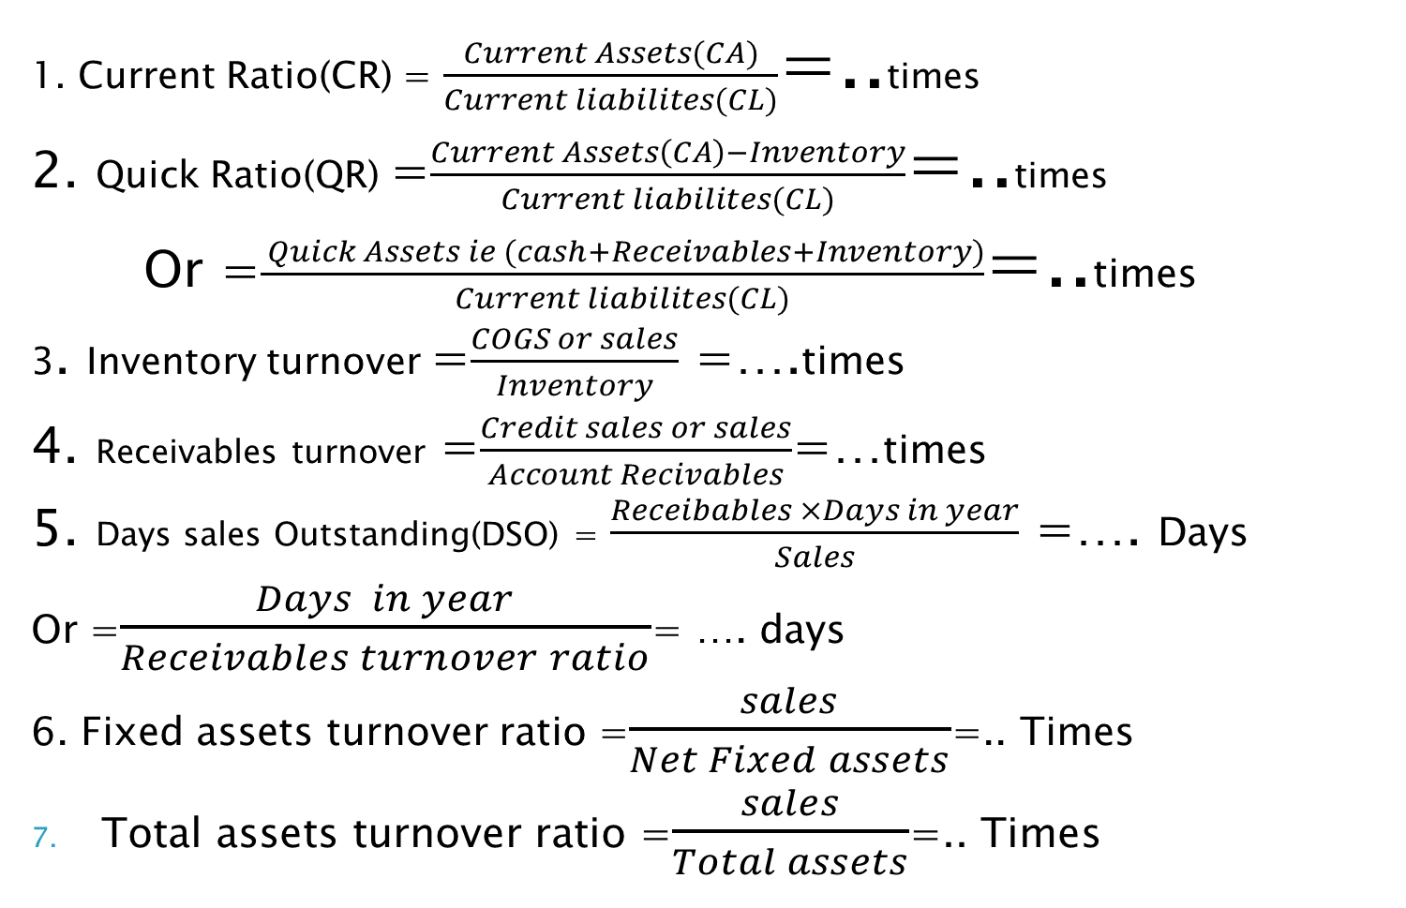
List of formulas
1. Current Ratio(CR) = $\frac{Current Assets(CA)}{Current liabilites(CL)}$=..times
2. Quick Ratio(QR) =$\frac{Current Assets\left(CA\right)−Inventory}{Current liabilites(CL)}$=..times
Or =$\frac{ Quick Assets ie (cash+Receivables+Inventory)}{Current liabilites(CL)}$=..times
3. Inventory turnover =$\frac{COGS or sales}{Inventory}$ =….times
4. Receivables turnover =$\frac{Credit sales or sales}{Account Recivables}$=…times
5. Days sales Outstanding(DSO) = $\frac{Receibables ×Days in year}{Sales}$ =…. Days
Or =$\frac{Days in year}{Receivables turnover ratio}$= …. days
6. Fixed assets turnover ratio =$\frac{sales}{Net Fixed assets}$=.. Times
Total assets turnover ratio =$\frac{sales}{Total assets}$=.. Times

Slide 18
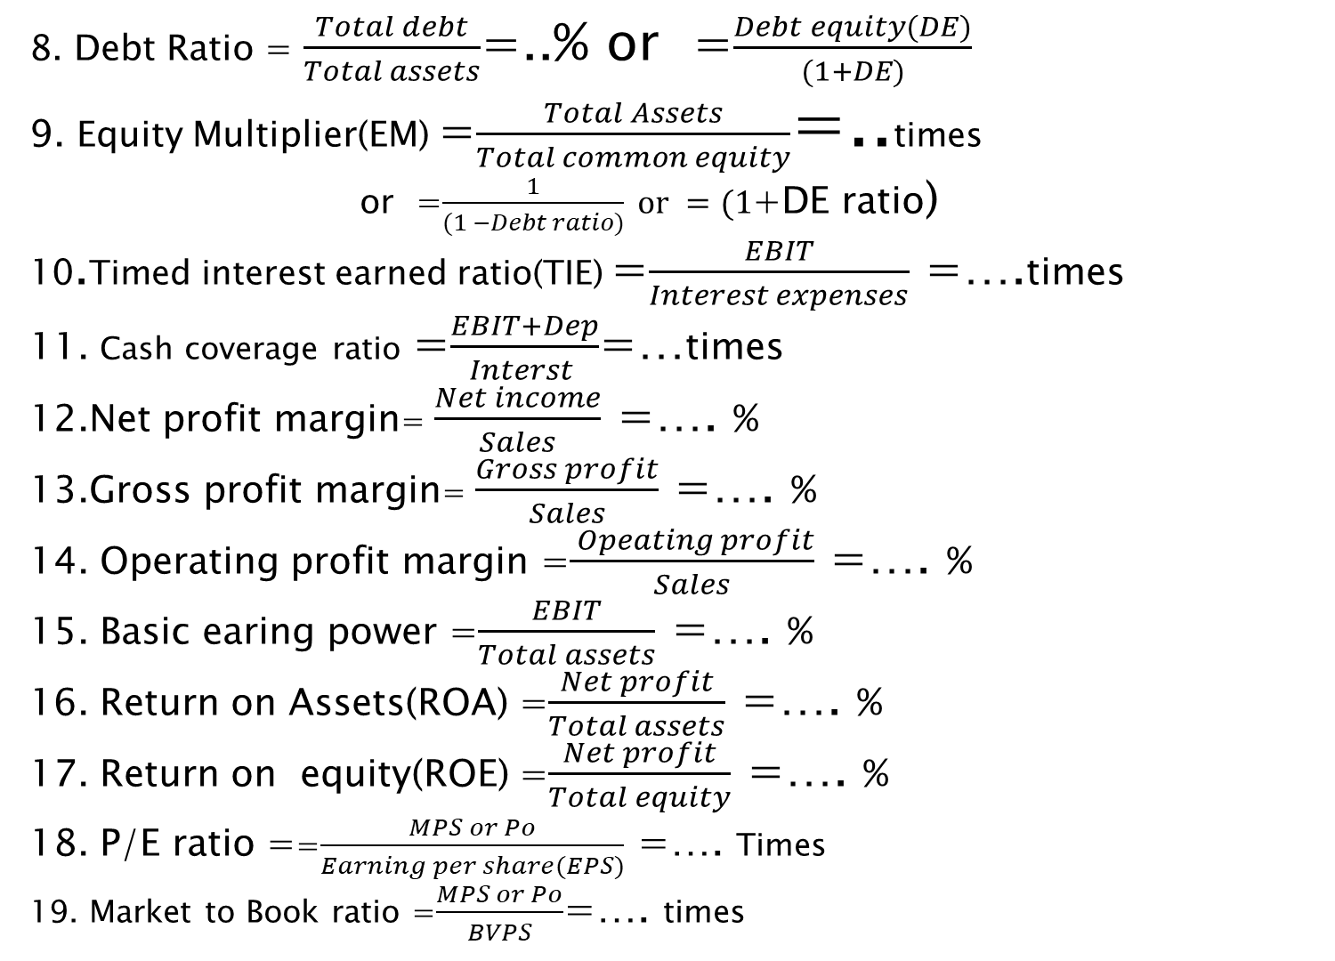
8. Debt Ratio = $\frac{Total debt}{Total assets}$=..% or =$\frac{Debt equity(DE)}{(1+DE)}$
9. Equity Multiplier(EM) =$\frac{Total Assets}{Total common equity}$=..times
or =$\frac{1}{(1 −Debt ratio)} or =(1$+DE ratio)
10.Timed interest earned ratio(TIE) =$\frac{EBIT}{Interest expenses}$ =….times
11. Cash coverage ratio =$\frac{EBIT+Dep}{Interst }$=…times
12.Net profit margin= $\frac{Net income}{Sales}$ =…. %
13.Gross profit margin= $\frac{Gross profit}{Sales}$ =…. %
14. Operating profit margin =$\frac{ Opeating profit}{Sales}$ =…. %
15. Basic earing power =$\frac{EBIT}{Total assets}$ =…. %
16. Return on Assets(ROA) =$\frac{Net profit}{Total assets}$ =…. %
17. Return on equity(ROE) =$\frac{Net profit}{Total equity}$ =…. %
18. P/E ratio ==$\frac{MPS or Po}{Earning per share(EPS)}$ =…. Times
19. Market to Book ratio =$\frac{MPS or Po}{BVPS}$=…. times

Slide 19

20. Book Value per share(BVPS) =$\frac{Shareholder equity}{Number of shares outstanding}=Rs …$
21. Earning per share(EPS) = $\frac{Net income}{Number of shares outstanding}=$ Rs…
22. Dividend per share(DPS) =$\frac{Dividend amount}{mber of shares outstanding}=$Rs ….
Under DuPont Equation
1.ROA = Profit margin × Total assets Turnover
2. ROE = ROA × Equity Multiplier(EM)
Where,
EM = $\frac{\text{Total} \text{assets}}{\text{Total} Equity}$
Or EM = 1 + D/E ratio
Or EM = $\frac{\text{1}}{\text{(}\text{1 }\text{− }\text{Debt} \text{ratio}\text{)}}$

Slide 20
BEST OF LUCK THANK YOU

